Slide 1
Multi-Class Hindi Hate Speech Classification using a Lexicon-Based Approach
Presented By:
Shubham Gupta - 11941140
Manas Wadhwa - 11940670
Prakanshul Saxena - 11940860

Slide 2
Abstract
Paper implementation - A Lexicon-based approach for Hate Speech Detection
https://gvpress.com/journals/IJMUE/vol10_no4/21.pdf
Hindi Corpus Dataset - Curated Collection of Hindi Tweets from Telegram Channels https://github.com/mohit19014/Hindi-Hostility-Detection-CONSTRAINT-2021
Rule based approach to apply sentiment/subjectivity analysis - Identification of polarity of sentiment expressions
Extract lexical features to build a lexicon -> Fed into a classifier
Testing on real-world web discourse

Slide 3
Introduction
Common in social media platforms such as Twitter, Facebook etc
Profanity filters exist but work only on swear and obscene words directly
Limited dealing with speech that targets communities where emotions are conveyed in masked formats.
Problem is bigger with regional languages
Research: Understanding context of sentences and hate comments and gauge hatefulness to a near perfect accuracy
An attempt to understand context of hate speech and classify profanity on a grade scale from 1-5

Slide 4
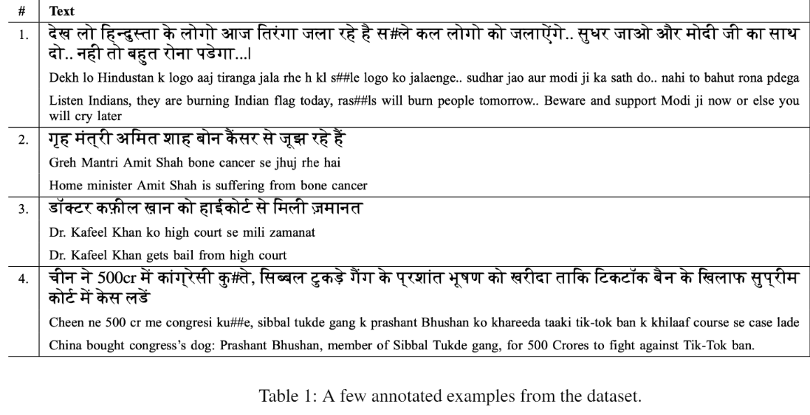
Dataset
Political and social issues are heavily polarized.
Lots of emotions attached -> Hate Speech Threads on Social Media
Model focuses on dealing with finding hate speech in contexts within these tweets
CSV formatted data

Slide 5
Implementation
3 steps
Subjectivity Analysis
Building hate lexicon
Identification of theme-based nouns

Slide 6
Subjectivity Analysis
Usage of https://amitavadas.com/sentiwordnet.php (SentiWordNet) which gives us the sentiments associated with a particular word in Hindi Language
Direct correlation between sentiments of sentences and objectivity i.e. it tells us that this sentence is a clean one based on presence of profanity words or not (Similar to 0-1 classification)
Key role in Data Reduction into sentences which are actually hateful and need to be classified
Negative scoring indicates hate speech presence and positive indicates absence

Slide 7
2. Building Hate Lexicon
Based on SentiWordNet scores associated with particular words and scores, detect negative polarity and hate content in tweets.
Scores < -0.25 -> Strongly Negative
-0.25 < Scores < 0 -> Weakly Negative
With this built, we add SYNSET (All possible synonyms) of these verbs and make a list of hateful verbs.
Adding on this, we add all verbs in the dataset vocabulary that belong to the SYNSET and add them to the hateful verb list.
Strongly Negative, Weakly Negative and Hateful Verbs is created

Slide 8
3. Theme-Based Noun Identification
Find nouns associated with relevant topic of discussion (specific to tweet)
Politically significant words are taken into account
Make a list of all distinct nouns from the corpus and take the most frequent NPs (Noun Phrases)
Few other commonly occurring noun words from Hindi Dictionary are added to this list
Can directly link nouns to context in which tweets are specified.
Provides insights into the Theme-Based Hate Speech Classification Task

Slide 9
Classification Task
Based on counting words that belong to the 4 above categories
Strongly Negative
Weakly Negative
Theme-Based Noun Presence
Hate Verbs
We classify the degree of profanity from 1-5. This is built upon the fact that it is strongly, weakly or zero hateful.

Slide 10
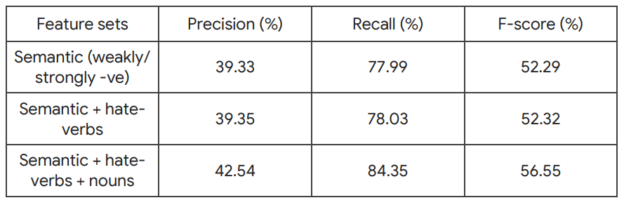
Results
Without Subjectivity Clues (On all the sentences) (8192 sentences)

Slide 11
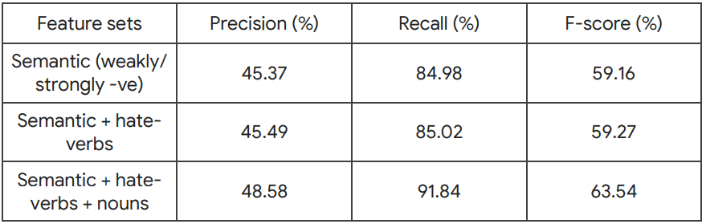
Results
With Subjectivity Clues (Only on negatively scored sentences) (4121 sentences)

Slide 12
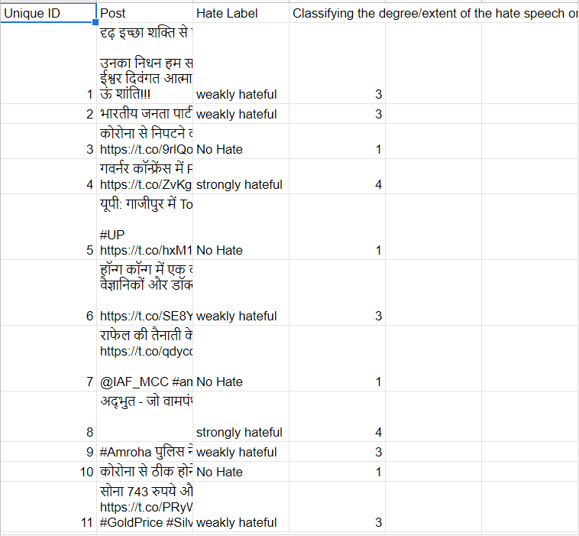
Classifier Output

Slide 13
What we can draw?
Impact of subjectivity. Using a baseline and reduction of dataset helps us to derive better results
Recall is much higher than Precision -> Tagging the hate speech tweets is good leaving very few false negatives (Misses)
Impact is significant -
We are able to quantify hate speech for a variety of reasons to a reasonable precision
Subjective classification of data eases the classification to a great deal
Speed -> Algorithm is of linear time complexity (O(N)) which gives us efficient speedup as the dataset can scale.
The paper implements the results for English language which is extended to Hindi. It shows that we can extend it to other regional languages.

Slide 14
Multi-Class Hindi Hate Speech Classification using LSTMs
Presented By:
Shubham Gupta - 11941140
Manas Wadhwa - 11940670
Prakanshul Saxena - 11940860

Slide 15
Problem
The problem elaborated in the former part of this presentation performs multi-class classification using a basic classifier. That classifier classifies into 3 classes - No Hate, Weak Hate, Strong Hate
In this part of the project we use deep learning based methods to perform multi-class classification for 5 classes -
Non-Hostile
Fake
Offensive
Hate
Defamation

Slide 16
Dataset Distribution
Category | No of instances
Defamation | 780
Fake | 1480
Hate | 886
Non-Hostile | 3699
Offensive | 566

Slide 17
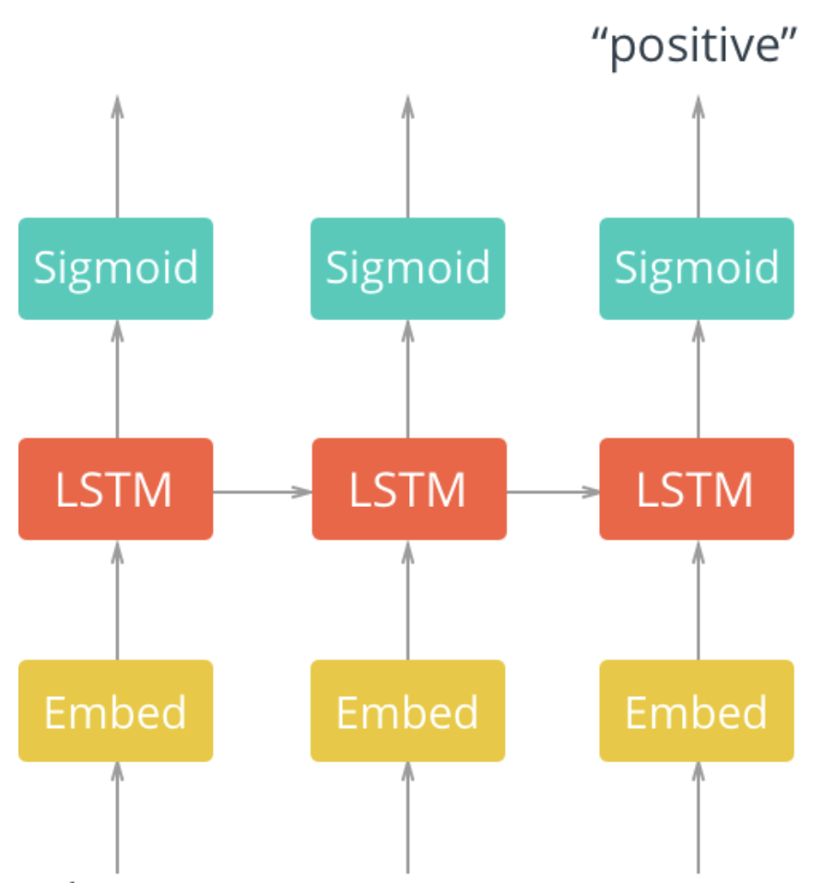
Approach
A two layer LSTM based network is used in which the first layer is the embedding layer and the second layer is the LSTM Layer.
The output for the multi-label classification is taken from the last cell of the network.
To perform this we have used Cross Entropy Loss.

Slide 18
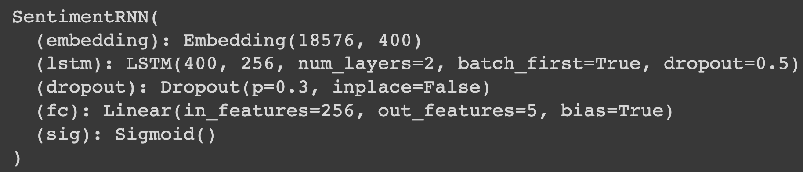
Approach (Model)

Slide 19
Hyper-Parameters
Loss - Cross Entropy Loss
Learning Rate - 0.001
Optimizer - Adam Optimizer
Dropout - 0.3
Epoch - 50
Batch Size - 50

Slide 20
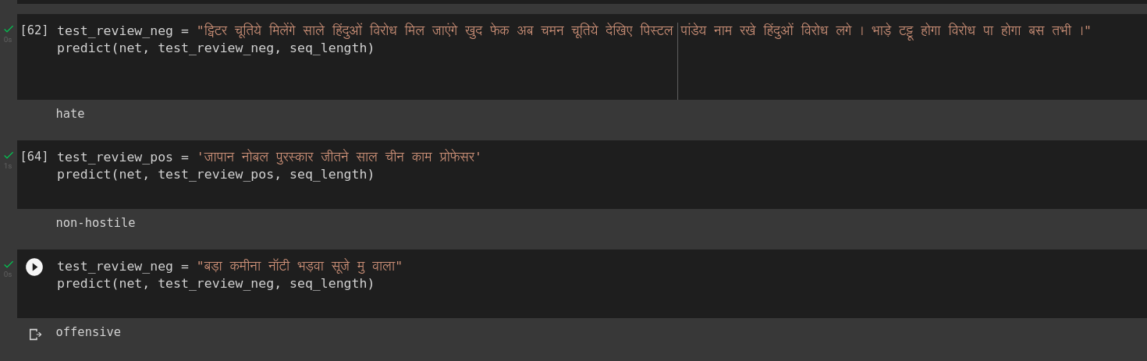
Results and Outputs
Test Dataset Accuracy - 57.1 +/- 1.98 % (5 runs) (Increase over the 0.41 precision in the previous approach)
Some Inferences

Slide 21
Novelty
Lexicon-Based Approach:
Paper implementation - A Lexicon-based approach for Hate Speech Detection - https://gvpress.com/journals/IJMUE/vol10_no4/21.pdf
Paper implementation is in English. Extended to Hindi to build lexicons, obtain accuracy (Precision, Recall, F1 Score) and classify the degree of sentences on a 1-5 scale
Focus on recall that we are able to reduce false negatives before actually dealing with a high accuracy
Multi-Class Classification - Multi-Class Classification works on this dataset or Hindi Language Dataset, have not been performed before.
Sentiment Analysis - Binary classification tasks on each class of this dataset (HINDI LANGUAGE specifically) have been done previously but we perform sentiment analysis based on the last cell output.

Slide 22
Contribution
Shubham Gupta - Research Paper Implementation (Lexicon-based Approach for Hate Speech Detection). Classifier built on top to classify hate speech on a scale of 1-5.
Prakanshul Saxena and Manas Wadhwa- Dataset Pre-Processing for Deep Learning Approach, LSTM Model Training and Hyper-Parameter Tuning on Hindi Dataset

Slide 23
Reasoning and Conclusion
This accuracy obtained is due to the following two phenomena -
Class Imbalance - As seen in the dataset distribution, the dataset is affected by class imbalance with large number of examples for non-hostile sentences.
Less Dataset Size - The online available dataset for “HINDI” Hate Speech detection were very few. And those present were not large enough in size for a considerable amount of deep-learning training for NLP.
So we conclude that we have increased the classification accuracy over the basic classifier baseline model (3 classes) while having to classify more classes (5 classes)

Slide 24
References
Hindi Sentiment WordNet: https://amitavadas.com/sentiwordnet.php
Research Paper: https://gvpress.com/journals/IJMUE/vol10_no4/21.pdf
Dataset: https://github.com/mohit19014/Hindi-Hostility-Detection-CONSTRAINT-2021
https://www.analyticsvidhya.com/blog/2021/10/hands-on-hindi-text-analysis-using-natural-language-processing-nlp/
https://pypi.org/project/indic-nlp-library/
https://www.analyticsvidhya.com/blog/2020/01/3-important-nlp-libraries-indian-languages-python/
https://arxiv.org/pdf/2101.05494v1.pdf

Slide 25
GitHub References
https://github.com/kamalojasv181/Hostility-Detection-in-Hindi-Posts
https://github.com/victorknox/Hate-Speech-Detection-in-Hindi
https://github.com/NakulLakhotia/Hate-Speech-Detection-in-Social-Media-using-Python
https://github.com/ecanbazer/hatred-speech-classifier
https://github.com/manikbhandari/hindi-word-embeddings
https://github.com/datascisteven/Automated-Hate-Tweet-Detection/tree/main/py
https://github.com/hate-alert/HateCheckHIn
https://github.com/punyajoy/HateSpeech-Hindi-English-Code-Mixed-Social-Media-Text
https://github.com/victor7246/Hinglish_Hate_Detection
https://github.com/pmathur5k10/Hinglish-Offensive-Text-Classification
https://github.com/udacity/deep-learning-v2-pytorch/tree/master/sentiment-rnn
https://github.com/kopalgarg/hate_speech_classification

